Slide 1

PRODYNA
THE POWER OF KNOWLEDGE GRAPHS

Slide 2
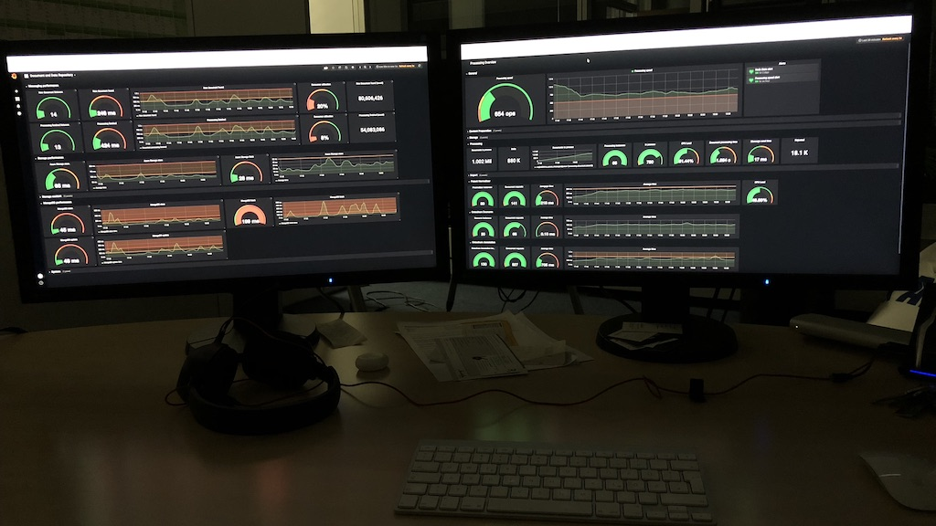

Slide 3

Kubernetes cluster
150 nodes
2300 cores
16TB RAM
Running on Azure
Development on Minikube
Running
15 business services
Developed by PRODYNA
Neo4j
ElasticSearch
MongoDB
RabbitMQ
Prometheus
Grafana

Slide 4
Technologies for development
Java | The actual ecosystem
Spring | Java framework for Microservices
Maven | Build and Dependency management
IntelliJ | Framework for development
Docker | Handling docker images

Slide 5
Technologies for RUNtime
Kubernetes | Orchestrator for clusters
Neo4j | Graph database
Docker | Used inside of Kubernetes
Prometheus | Collector for metrics
Grafana | Visualization for metrics

Slide 6
Starting point
Command line tools
maven – Building the sources
kubectl – Controlling Kubernetes
docker – Building and managing docker images
helm – For managing installations on Kubernetes
minikube – For managing a local installation of Kubernetes for development
virtualbox – The actual virtual machine minikube runs on
Other software
IntelliJ – The DIE used (many alternatives)
Java– The Java runtime and compiler

Slide 7
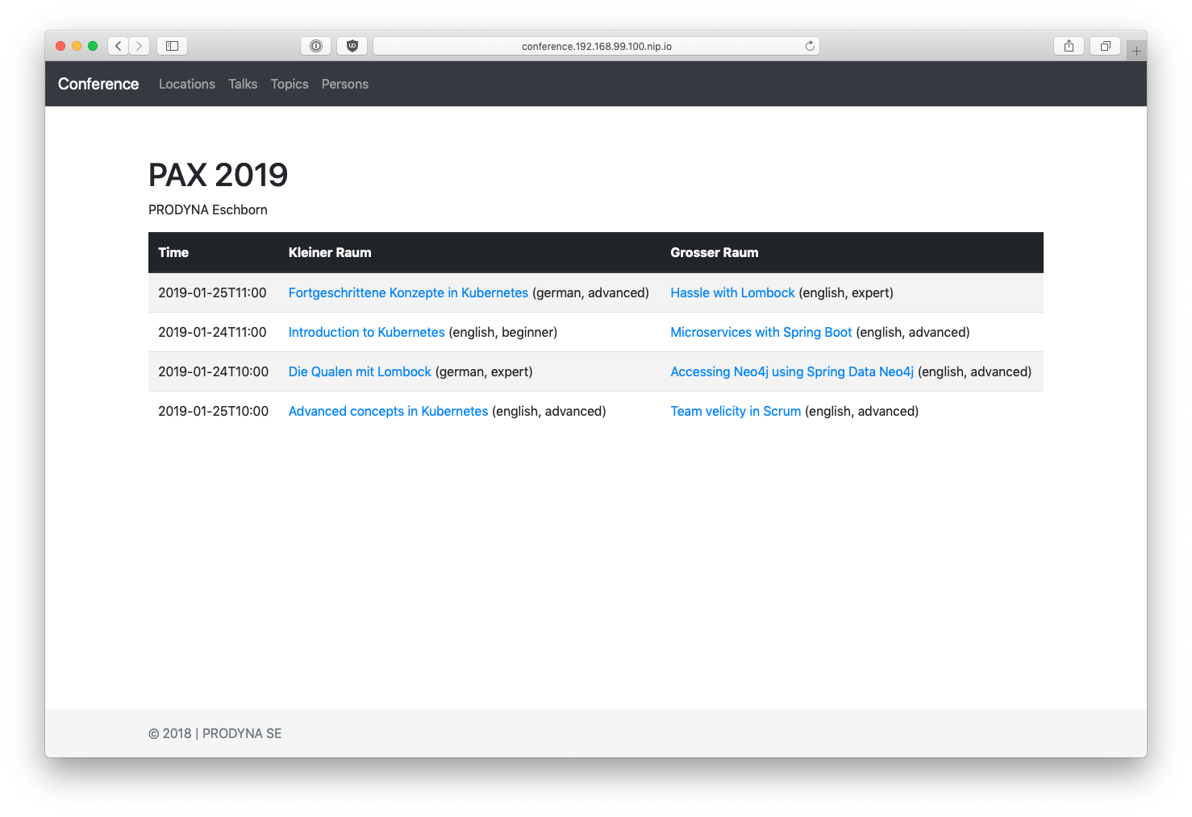
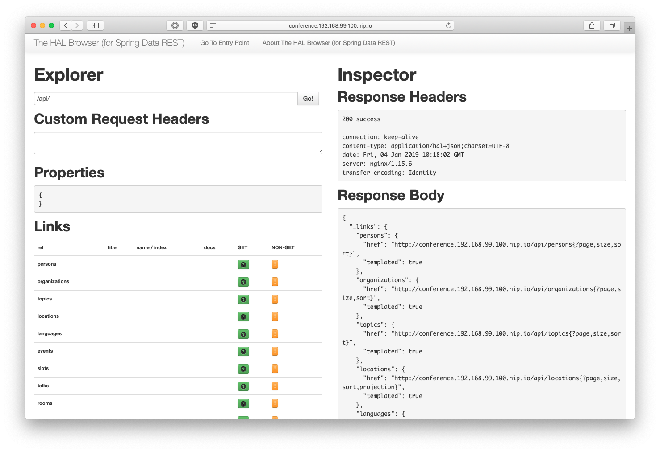
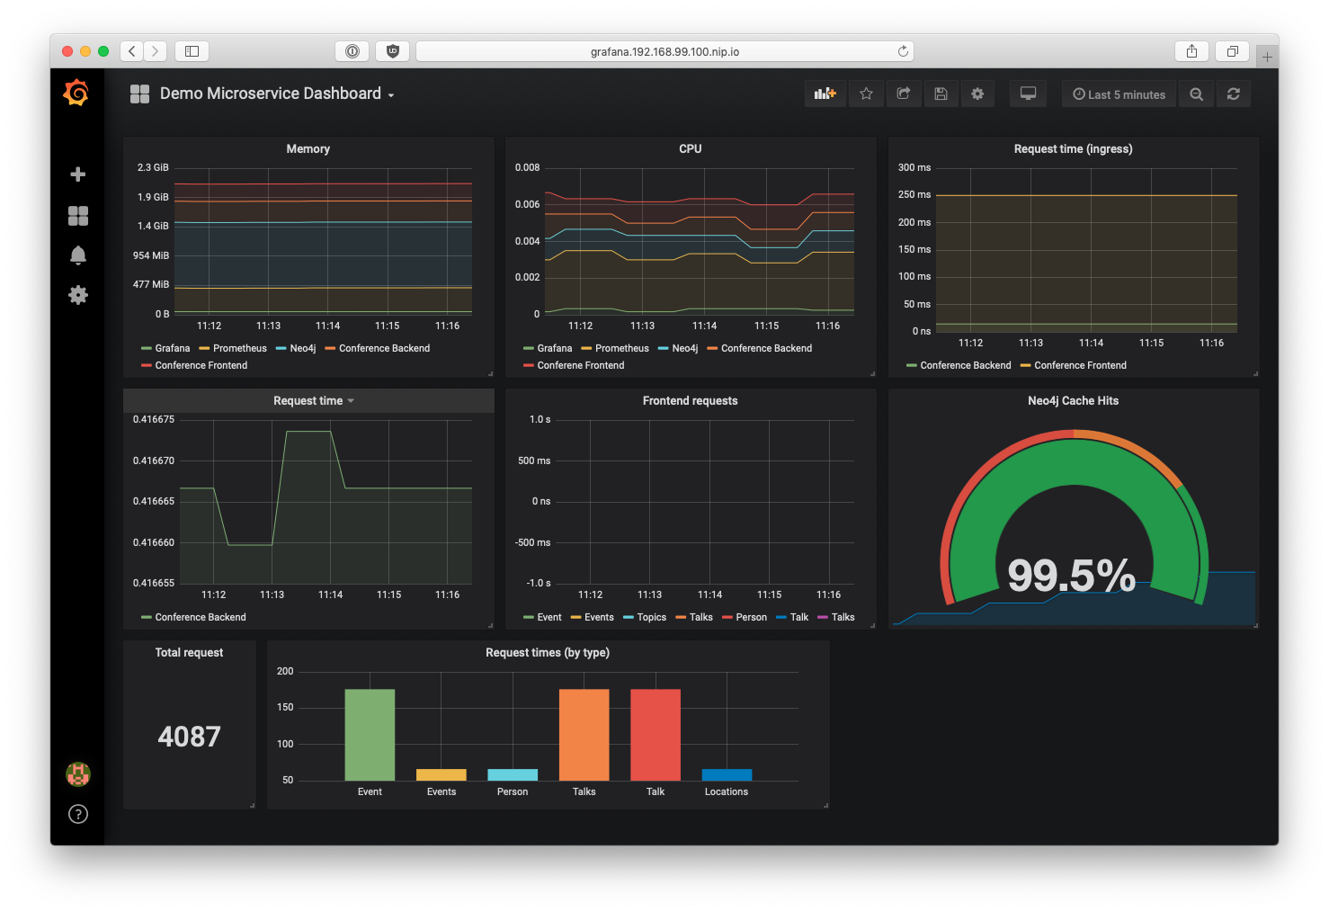
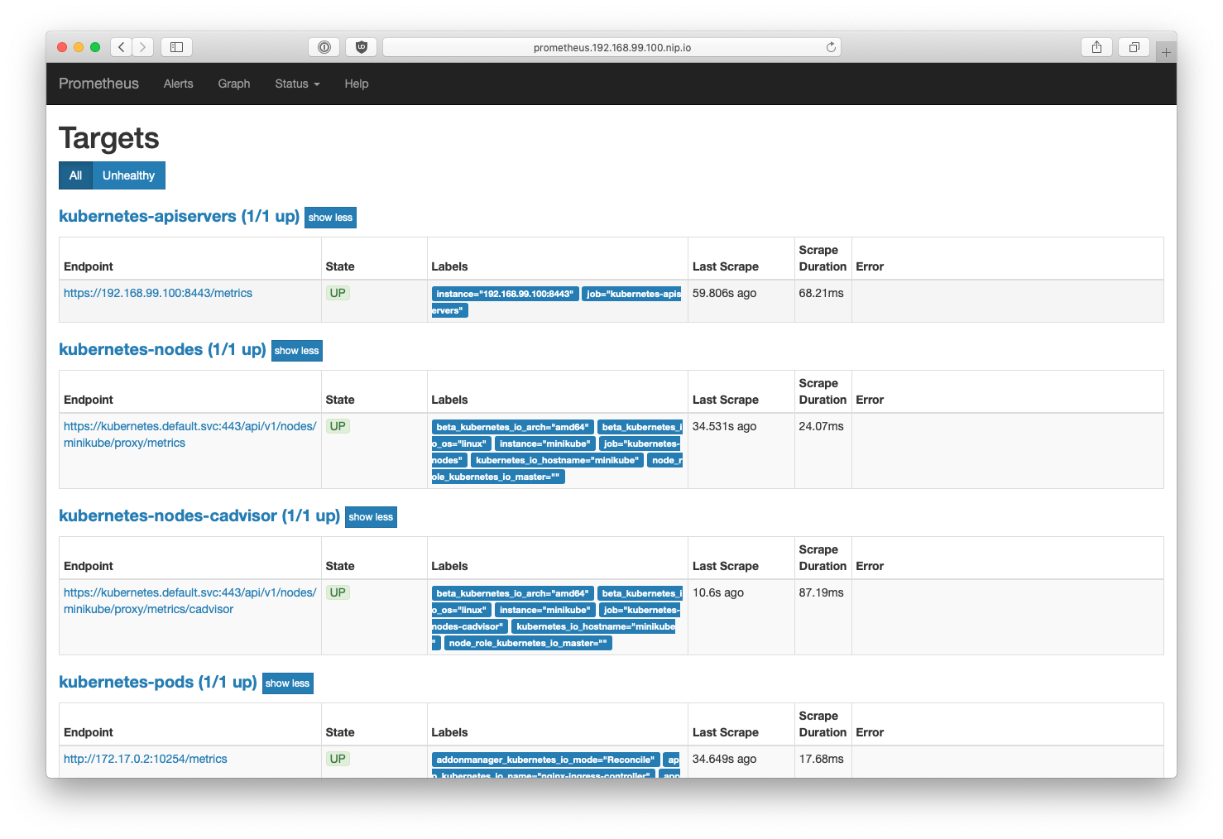
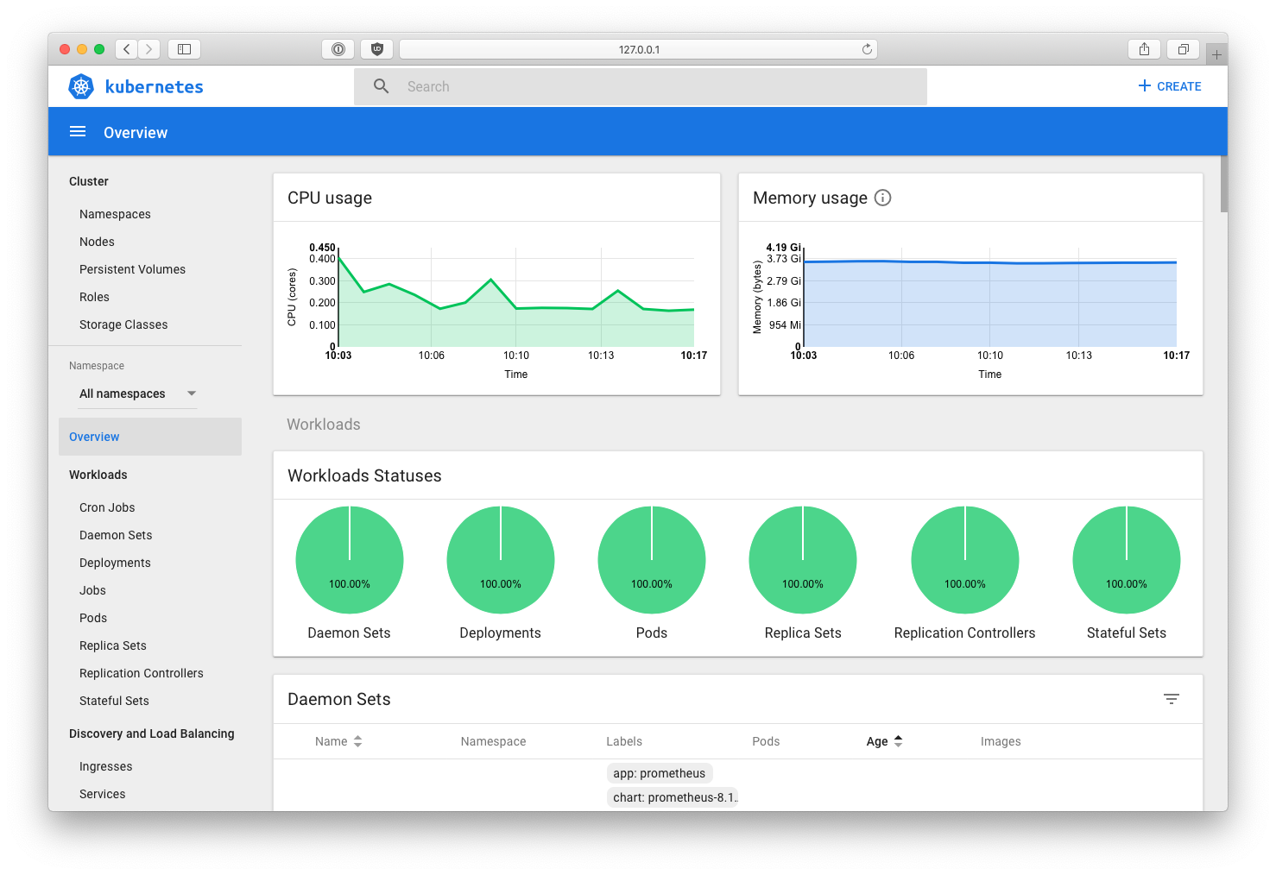
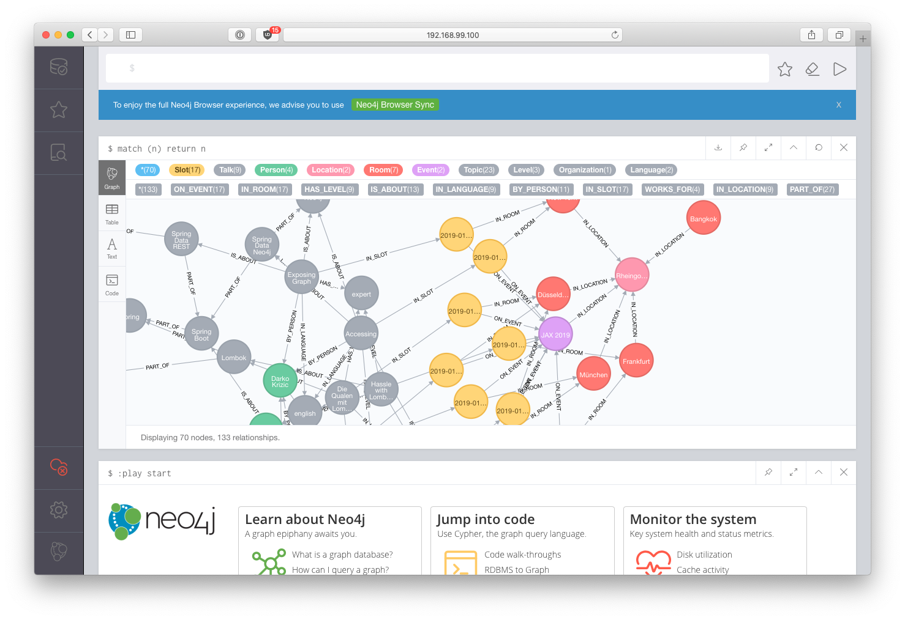
Conference
Frontend
http://conference.minikube/
Conference
Backend
conference/
80
conference/api
Ingress Controller
443
http://conference.minikube/api
Prometheus
prometheus
Dashboard
2001
grafana
Neo4j
Grafana
http://grafana.minikube/
Conference
Data
32K10
32K11
http://prometheus.minikube/
bolt://minikube:32001
http://minikube:2001/
Conference
Backend
Conference
Frontend
http://conference.minikube/api
http://minikube:32010
bolt://minikube:32011

